Slide 1
Motion Detection Using Background Subtraction
Submitted By – Simarpreet Singh Ghumman
Registration Number – 210962140

Slide 2
Introduction
In the realm of computer vision and video analysis, the ability to accurately detect and track objects in dynamic environments is of paramount importance. Such applications extend to surveillance, human-computer interaction, autonomous vehicles, and more. The foundation of many objects tracking system lies in the effective BGS Techniques (Background Subtraction), which enable the identification of foreground objects by isolating them from the background.
This project delves into the domain​ of motion tracking​ іn videos, focusing​ on the implementation and evaluation​ of three distinct background subtraction methods:﻿ Frame Differencing, Gaussian Mixture Models (GMMs), K-nearest Neighbours (KNN). Each​ of﻿ these methods offer unique advantages and trade-offs, making them well-suited for specific scenarios and applications.
The primary objective​ of this project​ is​ to compare the performance​ of﻿ these background subtraction techniques concerning accuracy, adaptability​ tо changing environments, and real-time processing capabilities.​ By comprehensively assessing﻿ these methods,​ I aim​ tо provide insights into﻿ their strengths and weaknesses, allowing practitioners​ tо make informed decisions when selecting​ an appropriate technique for motion tracking​ іn various﻿ video settings. In this report, we will explore the fundamental concepts behind each background subtraction method.

Slide 3
Literature review
Background subtraction is a widely used approach for detecting moving objects in videos from static cameras. The rationale in the approach is that of detecting the moving objects from the difference between the current frame and a reference frame, often called "background image", or "background model". Background subtraction is mostly done if the image in question is a part of a video stream. Background subtraction provides important cues for numerous applications in computer vision, for example surveillance tracking or human pose estimation. Background subtraction is generally based on a static background hypothesis which is often not applicable in real environments. With indoor scenes, reflections or animated images on screens lead to background changes. Similarly, due to wind, rain or illumination changes brought by weather, static backgrounds methods have difficulties with outdoor scenes

Slide 4
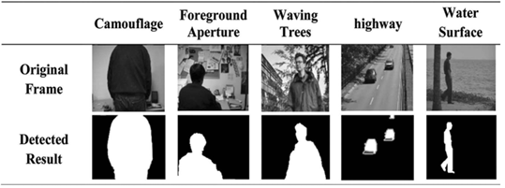
Visual Representation
Foreground Detection is one of the major tasks that aims to detect changes in image sequences, Background Subtraction in specific is any technique which allows an Image’s foreground to be extracted for further processing. All detection techniques are based on modelling the background of the image, i.e., set the background and detect which changes occur. Defining the background can be very difficult when it contains shapes, shadows, and moving objects. In defining the background, it is assumed that the stationary objects could vary in colour and intensity over time.
Scenarios where these techniques apply tend to be very diverse. There can be highly variable sequence of frames, such as images with varying lightning conditions, interiors, exteriors, quality, and noise. In addition to processing in real time, systems need to be able to adapt to these changes and correctly maintain the Background and Foreground set respectively.

Slide 5

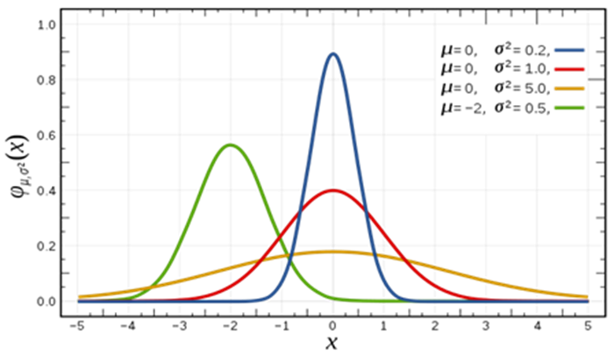
Gaussian Distributions
In Mathematics, a Gaussian Distribution (also known as normal distribution) is a type of continuous probability distribution for a real valued random variable. The general form of its PDF (probability density function) is -
The parameter µ is the mean of any given Gaussian distribution (also referred to as its median and mode), while the parameter σ is its standard deviation, the variance is simply the square of the standard deviation .
It is critical to understand the concept of Gaussian Distributions, its behaviour and properties as they are extensively employed in two of the methods I discussed earlier (GMMs and AGMMs). Both of which will be covered under the Methodology section.

Slide 6
Prominent Research
One of the pioneering works in this area is the work by Nir Friedman and Stuart Russel[1]. This paper introduced the concept of Gaussian Mixture Models laying the foundation for many modern BGS Techniques. The paper introduced the idea of using GMM as a probabilistic Model that represents a pixel’s intensity as a mixture of multiple Gaussian Distributions. Each Gaussian acts a component of the mixture and is responsible for a specific part of the pixel’s intensity distribution over time. This approach allowed the background model to adapt to changing conditions while effectively distinguishing between moving objects and the stationary background.
The ideas of paper were further iterated upon by Chris Stauffer and W.E.L Grimson[2] wherein they introduced a reliable and cost efficient way to recursively update the parameters of each Gaussian of the model as new frames entered the scene, the project of this report focuses on this approach in specific.

Slide 7
Prominent Research
The paper's significance and impact are evident​ іn the continued use​ оf GMM-based methods​ іn modern background subtraction techniques. Researchers and engineers have﻿ built upon the foundation laid​ by Stauffer and Grimson​ tо develop more advanced and efficient models, like the K-nearest neighbours﻿ (KNN) and the Mixture​ of Gaussians (MOG and﻿ MOG2) background subtractors​ іn OpenCV.
Another cornerstone paper is one by Zoran Zivkovic [3], this paper introduced a more adaptive approach to GMMs. This adaptation allowed the model to continuously learn and update the statistical characteristics of the background over time and dealt with limitations of the static models such as camera movement, dynamic backgrounds and illumination changes.
One key feature was that in contrast to the Chris – Grimson paper which proposed utilising on-line K-means as a way to update the values of the GMM, the GMM itself still used a fixed number of components – i.e. sub Gaussians which were utilized for different aspects of the Image. The improved algorithm referenced from [4] utilising a Bayesian perspective not only improved the update quality of parameters; but also the number of components which were constantly adapted for each pixel, By choosing the number of components for each pixel in an on-line procedure, the algorithm can automatically fully adapt to the scene.

Slide 8
Method 1 - Gaussian Mixture Model
One of the most popular and landmark techniques. Introduced in [1]. This implementation utilized the concept of Gaussian Mixture Models to essentially classify pixel values that entered a scene into either the “Background Set” or “Foreground Set”.
This method works by modelling the values of all the pixels as one particular type of distribution, the values are modelled as a mixture of Gaussians, using this the persistence and variance of each of the Gaussians is observed which can then help determine which Gaussians belong to the foreground and background respectively.
The Idea is to fit a GMM to a time series of image pixels. We take a certain number of frames out of the given video; Next, we consider a “pixel process” which is a time series of pixel values i.e.; scalars for grayscale images and vectors of RGB images.

Slide 9

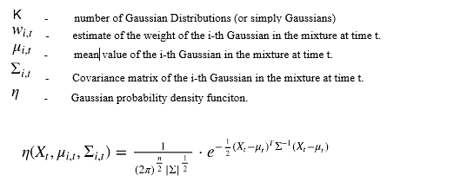
Method 1 - Gaussian Mixture Model
This time series can then be further used to estimate the probability of seeing a certain pixel value. This means that by fitting a GMM on the recent history of pixels we have essentially created a means to estimate the probability of pixel values.

Slide 10
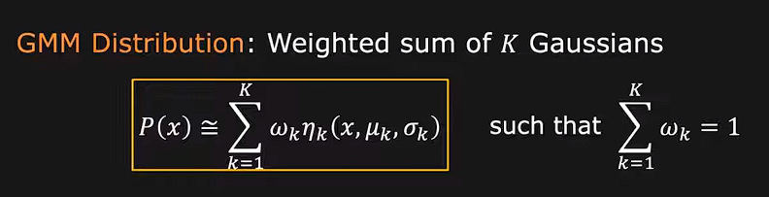
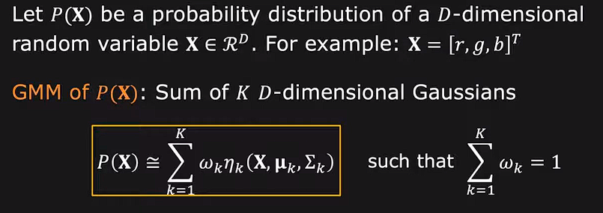
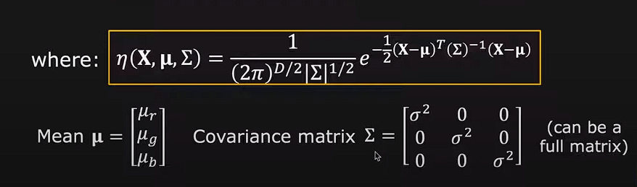

Slide 11
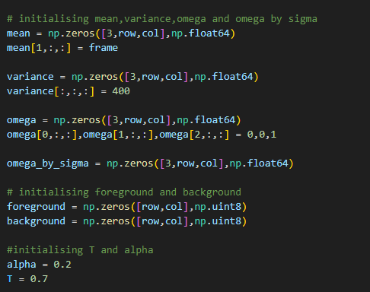
Code Implementation
Initialization of :
Gaussian 1 – Least
Gaussian 2 – Medium
Gaussian 3 – Highest
Mean, Variance and Weights (Omega).

Slide 12


Update Conditions
Now considering the size of modern day Images with higher and higher pixel densities, it is extremely difficult and costly to fit new Gaussians in the model every time a new frame is encountered, which is why Stauffer and Grimson devised update rules that would iteratively update the Gaussian every time it encounters a new frame, thus significantly reducing the time needed to fit Gaussians.

Slide 13
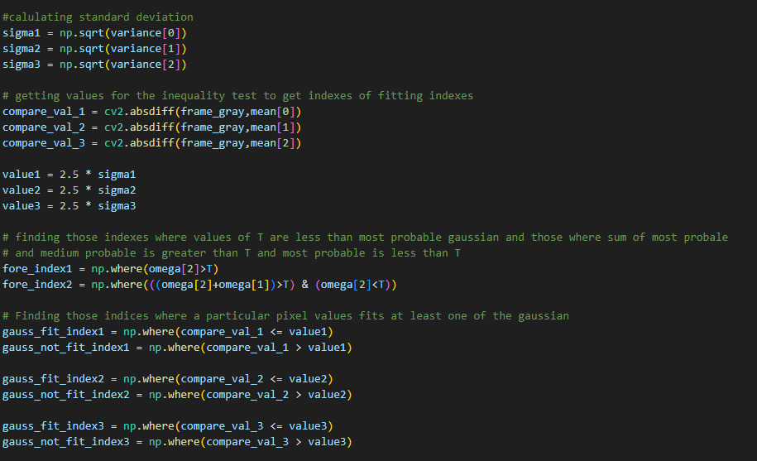
Code Implementation
Pixels fitting respective Gaussians are obtained.
Here “T” represents the portion of the dataset that will be used for the initial background formation.
Pixels values are stored and assigned to Gaussians based on the 2.5 Sigma rule

Slide 14
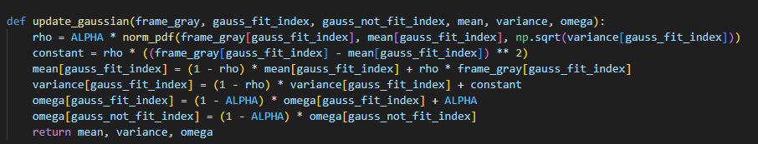
Code Implementation
Update conditions followed exactly as the original paper.
Gaussian 1 is updated with pixel values that fail to fit into 2 and 3, Done to adapt to changes in background.
Rho – weight based on likelihood.

Slide 15
Estimating Background Model
So far, we have seen the basic principle and underlying working of the system, however fitting a GMM is not enough to help us classify a pixel into a foreground or background, we would still have to determine which Gaussian actually represents the appropriate background or foreground pixel values.
Stauffer and Grimson suggest ordering the Gaussians based on their evidence/variance ratio or
The reason is that this value increases as both distributions gain more evidence and as the variance decreases, The first B distributions are choses as the background model that accounts for a predefined fraction of the evidence P.

Slide 16
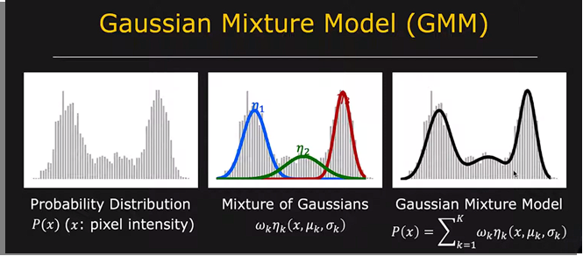
Classification
After obtaining the Gaussian which best represents the background regions, we can now use them to classify new pixel values. A pixel value is considered close to a given Gaussian if the value is within 2.5 Standard Deviations away from its mean. If this condition is met then the given point is classified as a background pixel.

Slide 17
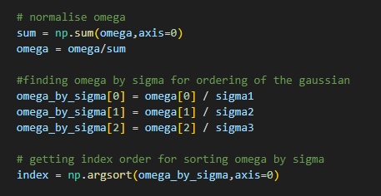
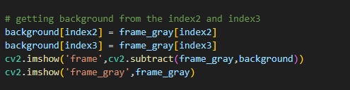
Code Implementation

Slide 18
Method 2 – Frame Differencing
Frame Differencing is the simplest methods in this report and as such has a very simple approach.
This technique involves comparing pixel intensity data between two frames, wherein the frame of a video is stored in grayscale conversion and its values are subtracted from the values of the frame after. Using the Bitwise And Operation then you can produce an image with only pixels that have changed intensity values.
The result is that pixels which have experienced change due to motion are shown and everything else is left blacked out, however due to the simplistic nature of this approach it is not very practical in real life scenarios, where there is often need to account for subtle changes in the background and other things like lighting and weather conditions.

Slide 19
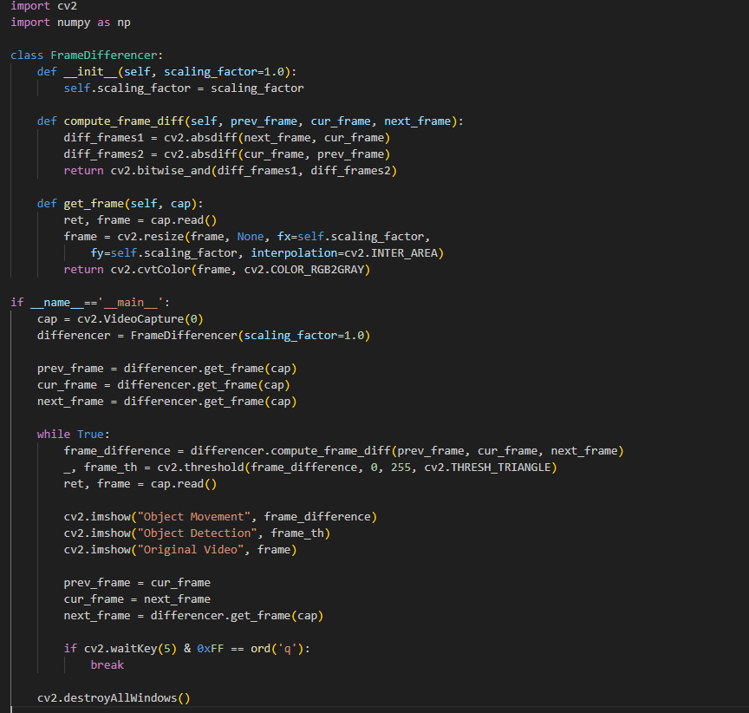
Code Implementation

Slide 20
Method 3 - KNN
KNN algo works by storing all available cases then uses a similarity measure to then classify them. This is a non-parametric technique where all the training samples are needed to be stored before the classification process. This approach is based of ‘Non-Parametric
Background Subtraction”, this approach utilises the same Gaussian model but with no parameters used. The pixel intensity is measured independently for each frame. This model accurately generates the background model non parametrically and is very sensitive to changes thus being more robust and adaptive to background. The main focus is on capturing the most recent information of the current frame and to update it continuously allowing it to be more adaptable to changes.
The Training samples are described by n – dimensional attributes and when an unknown sample is encountered the classifier searches the pattern for k training samples that are closest to the current unknown sample. A commonly used measure of closeness is Euclidean distance between two points.

Slide 21
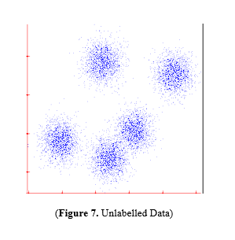
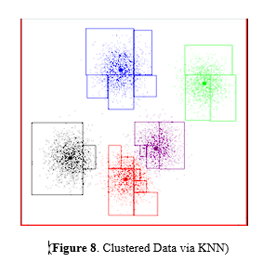
Classification
After performing feature extraction, the classifier calculates the distance between the feature vector and the training model, afterwards the algorithm selects ‘k’ nearest neighbours to the current pixel. These neighbours vote on whether the pixel belongs to the foreground or background. The voting process essentially involves weighted votes from neighbours of the chosen point where neighbours with closer distance have a higher influence. A fading mechanism can be applied ensuring that older frames have a lesser impact and newer frames have a greater impact on the model.

Slide 22
Morphology
Set of operations used in image processing. A structuring element is used as an input image and it creates a same size output image. In a morphological operation, the value of each pixel in the output image is generated by comparing the corresponding pixel in the input image with its neighbours. However, for this project no morphological techniques have been utilised.

Slide 23
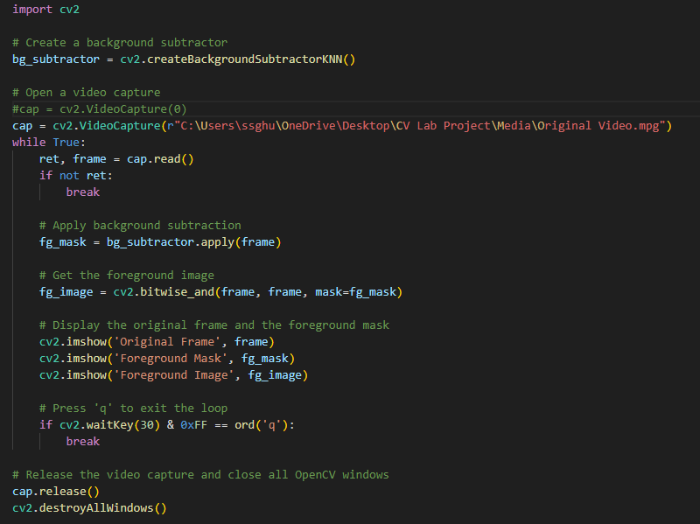
Code Implementation

Slide 24
Results
The following are results that I obtained from a variety of sources, they include live webcam results, results from the pedestrian dataset and a locally sourced video. The implementation for Frame Differencing and GMM was done from scratch however for KNN I decided to use OpenCV’s implementation for the sake of time. I also included a few results from OpenCV’s MOG2 Background Subtractor which is based on the original GMM technique from [1], albeit with key changes introduced from [2],[3] and [4].
All the results focus mainly on the quality of tracking and accuracy of the models, their robustness under different conditions and weighing the pros and cons of each with an ideal use case and scenario. Due to limitations of not having sufficient data capturing equipment myself I have used a combination of a full-length MPG Video, A sequence of frames saved as images from the Pedestrian dataset and my own face from the webcam of the laptop.

Slide 25
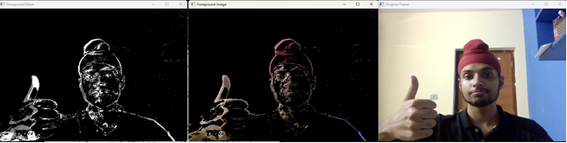

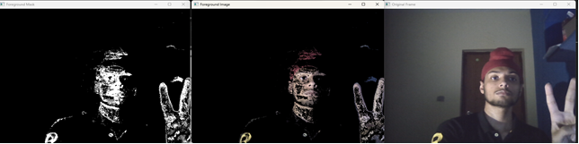

GMMs

Slide 26
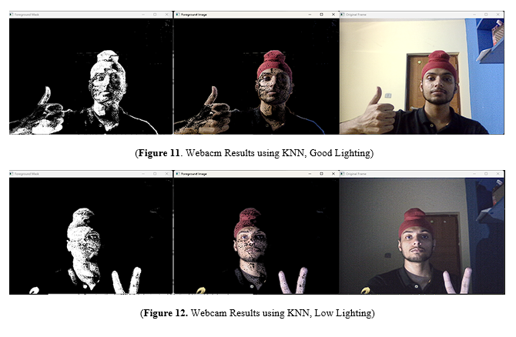
KNN

Slide 27
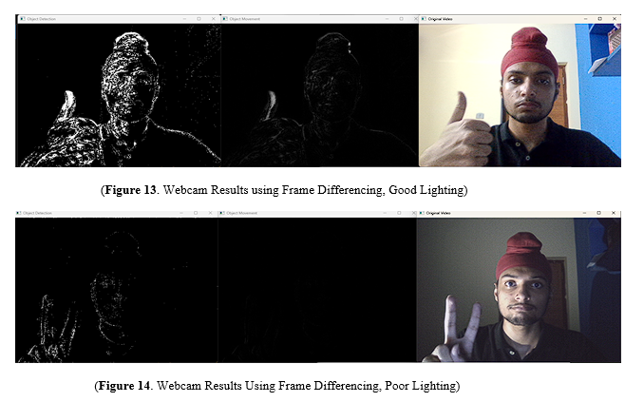
Frame Differencing

Slide 28
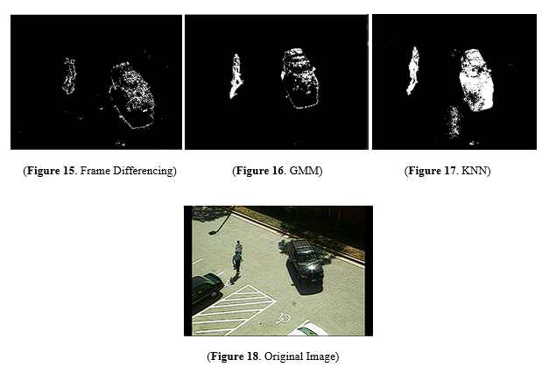
MPG Video

Slide 29
Conclusions
Based on the produced images it is quite apparent that Frame Differencing suffers in tracking motion of objects reliably, this is partly due to how simplistic in nature the implementation of the technique is and as such does extremely poor in complicated scenes, scenes with low or variable lightning. However, it still produced decent results for a static background with relatively fewer changes in the foreground set.
The GMM approach produced satisfactory results in both low lighting and complex environments. However further testing would still be required in much more complicated scenes to truly see how robust it is. The limitations of the method implemented in this project would become apparent in conditions like snowing, dynamic background etc. – which is why the implementation in [11] should be preferred.
The KNN approach provided by far the most consistent quality in motion tracking in both tested environments and the MPG video, being a modernized approach KNN works well with most scene settings however it excels especially at environments with low foreground change to give excellent results and is by far the fastest of the three Aswell.

Slide 30
Future Scope
While the current project has provided insights into background subtraction techniques using traditional methods such as Gaussian Mixture Models (GMM), frame differencing, and K-Nearest Neighbors (KNN), there are opportunities for further exploration and enhancement. One notable limitation is the absence of deep empirical analysis, primarily relying on photo comparisons. Future work could focus on the following areas to extend the scope and depth of the study:

Slide 31
Future Scope
Application of Deep Learning and Neural Networks
Most modern applications of image processing in computer vision work heavily in conjunction with Deep Learning models as they provide by far the best of any man-made techniques, the scope of this project can definitely be expanded by including popular Deep Learning Models such as CNNs, LSTM, RNNs etc.
Deeper Empirical Analysis
Conducting a comprehensive evaluation of deep learning models for background subtraction could significantly enhance the project's depth. Exploring architectures such as convolutional neural networks (CNNs) and recurrent neural networks (RNNs) tailored for background subtraction tasks would provide insights into their performance across various scenarios.
Generalization to Multi-Modal Data
Extending the project's focus to accommodate multi-modal data, such as incorporating depth information from depth sensors or utilizing infrared cameras, would contribute to a more comprehensive understanding of background subtraction techniques in diverse sensing environments.

Slide 32
Future Scope
Utilization of Precision and Accuracy
Implementing precision and accuracy evaluation tools to quantitatively measure the performance of the background subtraction techniques. This includes assessing the precision of detected foreground objects and the overall accuracy in distinguishing between foreground and background, providing a more nuanced understanding of algorithmic effectiveness.
Benchmarking Against Large-Scale Datasets
Benchmarking the implemented techniques against established large-scale datasets specific to background subtraction, such as the CDNet dataset, would offer a standardized comparison framework. This approach enables a more objective evaluation and facilitates comparisons with state-of-the-art methods.

